Slide 1
Information Security: Level #4
Network Security: A re-cap
Notes:
(C): James F. Kurose and Keith W. Ross
(C): James F. Kurose and Keith W. Ross

Slide 2
What is network security?
Confidentiality: only sender, intended receiver should “understand” message contents
  sender encrypts message
  receiver decrypts message
Authentication: sender, receiver want to confirm identity of each other
Message Integrity: sender, receiver want to ensure message not altered (in transit, or afterwards) without detection
Access and Availability: services must be accessible and available to users
Notes:
(C): James F. Kurose and Keith W. Ross
(C): James F. Kurose and Keith W. Ross

Slide 3



Friends and enemies: Alice, Bob, Trudy
well-known in network security world
Bob, Alice want to communicate “securely”
Trudy (intruder) may intercept, delete, add messages
Alice
Bob
channel
data, control messages
secure
sender
secure
receiver
data
data
Trudy
Notes:
(C): James F. Kurose and Keith W. Ross
(C): James F. Kurose and Keith W. Ross

Slide 4
Who might Bob, Alice be?
… well, real-life Bobs and Alices!
Web browser/server for electronic transactions (e.g., on-line purchases)
on-line banking client/server
DNS servers
routers exchanging routing table updates
other examples?
Notes:
(C): James F. Kurose and Keith W. Ross
(C): James F. Kurose and Keith W. Ross

Slide 5
There are bad guys (and girls) out there!
Q: What can a “bad guy” do?
A: a lot!
  eavesdrop: intercept messages
  actively insert messages into connection
  impersonation: can fake (spoof) source address in packet (or any field in packet)
  hijacking: “take over” ongoing connection by removing sender or receiver, inserting himself in place
  denial of service: prevent service from being used by others (e.g., by overloading resources)
more on this later ……
Notes:
(C): James F. Kurose and Keith W. Ross
(C): James F. Kurose and Keith W. Ross

Slide 6

The language of cryptography
Alice’s
encryption
key
Bob’s
decryption
key
K
K
A
B
encryption
algorithm
ciphertext
decryption
algorithm
plaintext
plaintext
symmetric key crypto: sender, receiver keys identical
public-key crypto: encryption key public, decryption key secret (private)
Notes:
(C): James F. Kurose and Keith W. Ross
(C): James F. Kurose and Keith W. Ross

Slide 7
Symmetric key cryptography
substitution cipher: substituting one thing for another
  monoalphabetic cipher: substitute one letter for another
plaintext: abcdefghijklmnopqrstuvwxyz
ciphertext: mnbvcxzasdfghjklpoiuytrewq
E.g.:
Plaintext: bob. i love you. alice
ciphertext: nkn. s gktc wky. mgsbc
Q: How hard to break this simple cipher?:
  brute force (how hard?)
  other?
Notes:
(C): James F. Kurose and Keith W. Ross
(C): James F. Kurose and Keith W. Ross

Slide 8
Symmetric key cryptography
K
K
A-B
A-B
plaintext
message, m
encryption
algorithm
ciphertext
decryption
algorithm
plaintext
K (m)
m = K ( )
K (m)
A-B
A-B
A-B
Most commonly used algorithms: DES, AES, 3AES
Notes:
(C): James F. Kurose and Keith W. Ross
(C): James F. Kurose and Keith W. Ross

Slide 9

Public Key Cryptography
symmetric key crypto
requires sender, receiver know shared secret key
Q: how to agree on key in first place (particularly if never “met”)?
public key cryptography
radically different approach [Diffie-Hellman76, RSA78]
sender, receiver do not share secret key
public encryption key known to all
private decryption key known only to receiver
Notes:
(C): James F. Kurose and Keith W. Ross
(C): James F. Kurose and Keith W. Ross

Slide 10
Public key cryptography
+
Bob’s public
key
K
B
-
Bob’s private
key
K
B
plaintext
message, m
encryption
algorithm
ciphertext
decryption
algorithm
plaintext
message
+
K (m)
-
+
B
m = K (K (m))
B
B
Notes:
(C): James F. Kurose and Keith W. Ross
(C): James F. Kurose and Keith W. Ross

Slide 11
RSA: another important property
The following property will be very useful later:
-
+
+
-
K (K (m)) = m
=
K (K (m))
B
B
B
B
use public key first, followed by private key
use private key first, followed by public key
Result is the same!
Notes:
(C): James F. Kurose and Keith W. Ross
(C): James F. Kurose and Keith W. Ross

Slide 12
Digital Signatures
Cryptographic technique analogous to hand-written signatures.
sender (Bob) digitally signs document, establishing he is document owner/creator.
verifiable, nonforgeable: recipient (Alice) can prove to someone that Bob, and no one else (including Alice), must have signed document
Notes:
(C): James F. Kurose and Keith W. Ross
(C): James F. Kurose and Keith W. Ross

Slide 13
Digital Signatures
Simple digital signature for message m:
Bob signs m by encrypting with his private key K_{B}, creating “signed” message, K_{B}(m)
-
-
Bob’s message, m
-
Bob’s private
key
-
K
K
B
(m)
B
Dear Alice
I will meet you tomorrow morning! …(blah blah blah)
Bob
Public key
encryption
algorithm
Bob’s message, m, signed (encrypted) with his private key
Notes:
(C): James F. Kurose and Keith W. Ross
(C): James F. Kurose and Keith W. Ross

Slide 14
Digital Signatures (more)
Suppose Alice receives msg m, digital signature K_{B}(m)
Alice verifies m signed by Bob by applying Bob’s public key K_{B} to K_{B}(m) then checks K_{B}(K_{B}(m) ) = m.
If K_{B}(K_{B}(m) ) = m, whoever signed m must have used Bob’s private key.
-
+
-
+
-
+
-
Alice thus verifies that:
  Bob signed m.
  No one else signed m.
  Bob signed m and not m’.
Non-repudiation:
  Alice can take m, and signature K_{B}(m) to court and prove that Bob signed m.
-
Notes:
(C): James F. Kurose and Keith W. Ross
(C): James F. Kurose and Keith W. Ross

Slide 15
Message Digests
large
message
m
H: Hash
Function
Goal: fixed-length, easy- to-compute digital “fingerprint”
apply hash function H to m, get fixed size message digest, H(m).
H(m)
Hash function properties:
produces fixed-size msg digest (fingerprint)
given message digest x, computationally infeasible to find m such that x = H(m)
Notes:
(C): James F. Kurose and Keith W. Ross
(C): James F. Kurose and Keith W. Ross

Slide 16
Hash Function Algorithms
MD5 hash function widely used (RFC 1321)
  computes 128-bit message digest in 4-step process.
  arbitrary 128-bit string x, appears difficult to construct msg m whose MD5 hash is equal to x.
SHA-1 is also used.
  US standard [NIST, FIPS PUB 180-1]
  160-bit message digest
Notes:
(C): James F. Kurose and Keith W. Ross
(C): James F. Kurose and Keith W. Ross

Slide 17
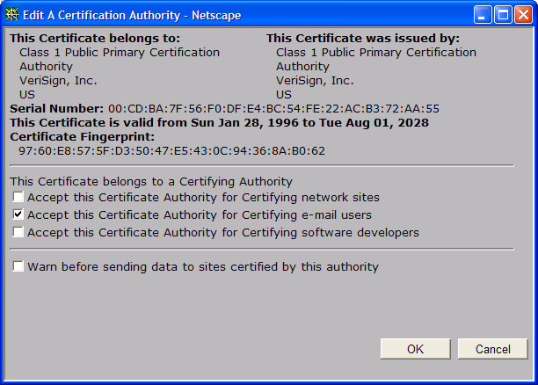
A certificate contains:
Serial number (unique to issuer)
info about certificate owner, including algorithm and key value itself (not shown)
info about certificate issuer
valid dates
digital signature by issuer
Notes:
(C): James F. Kurose and Keith W. Ross
(C): James F. Kurose and Keith W. Ross

Slide 18
Thank You
Notes:
(C): James F. Kurose and Keith W. Ross
(C): James F. Kurose and Keith W. Ross

Slide 19
Information Security: Level #4
Network Components: A re-cap
Notes:
(C): James F. Kurose and Keith W. Ross
(C): James F. Kurose and Keith W. Ross

Slide 20
Firewalls
firewall
isolates organization’s internal net from larger Internet, allowing some packets to pass, blocking others.
administered
network
public
Internet
firewall
Notes:
(C): James F. Kurose and Keith W. Ross
(C): James F. Kurose and Keith W. Ross

Slide 21
Firewalls: Why
prevent denial of service attacks:
  SYN flooding: attacker establishes many bogus TCP connections, no resources left for “real” connections.
prevent illegal modification/access of internal data.
  e.g., attacker replaces govt. department’s homepage with something else
allow only authorized access to inside network (set of authenticated users/hosts)
two types of firewalls:
  application-level
  packet-filtering
Notes:
(C): James F. Kurose and Keith W. Ross
(C): James F. Kurose and Keith W. Ross

Slide 22
Packet Filtering
Should arriving packet be allowed in? Departing packet let out?
internal network connected to Internet via router firewall
router filters packet-by-packet, decision to forward/drop packet based on:
  source IP address, destination IP address
  TCP/UDP source and destination port numbers
  ICMP message type
  TCP SYN and ACK bits
Notes:
(C): James F. Kurose and Keith W. Ross
(C): James F. Kurose and Keith W. Ross

Slide 23
Packet Filtering
Example 1: block incoming and outgoing datagrams with IP protocol field = 17 and with either source or dest port = 23.
  All incoming and outgoing UDP flows and telnet connections are blocked.
Example 2: Block inbound TCP segments with ACK=0.
  Prevents external clients from making TCP connections with internal clients, but allows internal clients to connect to outside.
Notes:
(C): James F. Kurose and Keith W. Ross
(C): James F. Kurose and Keith W. Ross

Slide 24

Application gateways
gateway-to-remote
host telnet session
host-to-gateway
telnet session
Filters packets on application data as well as on IP/TCP/UDP fields.
Example: allow select internal users to telnet outside.
application
gateway
router and filter
1. Require all telnet users to telnet through gateway.
2. For authorized users, gateway sets up telnet connection to dest host. Gateway relays data between 2 connections
3. Router filter blocks all telnet connections not originating from gateway.
Notes:
(C): James F. Kurose and Keith W. Ross
(C): James F. Kurose and Keith W. Ross

Slide 25
Limitations of firewalls and gateways
IP spoofing: router can’t know if data “really” comes from claimed source
if multiple app’s. need special treatment, each has own app. gateway.
client software must know how to contact gateway.
  e.g., must set IP address of proxy in Web browser
filters often use all or nothing policy for UDP.
tradeoff: degree of communication with outside world, level of security
many highly protected sites still suffer from attacks.
Notes:
(C): James F. Kurose and Keith W. Ross
(C): James F. Kurose and Keith W. Ross

Slide 26
Internet security threats
Mapping:
  before attacking: “case the joint” – find out what services are implemented on network
  Use ping to determine what hosts have addresses on network
  Port-scanning: try to establish TCP connection to each port in sequence (see what happens)
  nmap (http://www.insecure.org/nmap/) mapper: “network exploration and security auditing”
Countermeasures?
Notes:
(C): James F. Kurose and Keith W. Ross
(C): James F. Kurose and Keith W. Ross

Slide 27
Internet security threats
Mapping: countermeasures
  record traffic entering network
  look for suspicious activity (IP addresses, ports being scanned sequentially)
Notes:
(C): James F. Kurose and Keith W. Ross
(C): James F. Kurose and Keith W. Ross

Slide 28
Internet security threats
Packet sniffing:
  broadcast media
  promiscuous NIC reads all packets passing by
  can read all unencrypted data (e.g. passwords)
  e.g.: C sniffs B’s packets
A
C
src:B dest:A payload
B
Countermeasures?
Notes:
(C): James F. Kurose and Keith W. Ross
(C): James F. Kurose and Keith W. Ross

Slide 29
Internet security threats
Packet sniffing: countermeasures
  all hosts in organization run software that checks periodically if host interface in promiscuous mode.
  one host per segment of broadcast media (switched Ethernet at hub)
A
C
src:B dest:A payload
B
Notes:
(C): James F. Kurose and Keith W. Ross
(C): James F. Kurose and Keith W. Ross

Slide 30
Internet security threats
IP Spoofing:
  can generate “raw” IP packets directly from application, putting any value into IP source address field
  receiver can’t tell if source is spoofed
  e.g.: C pretends to be B
A
C
src:B dest:A payload
B
Notes:
(C): James F. Kurose and Keith W. Ross
(C): James F. Kurose and Keith W. Ross

Slide 31
Internet security threats
IP Spoofing: ingress filtering
  routers should not forward outgoing packets with invalid source addresses (e.g., datagram source address not in router’s network)
A
C
src:B dest:A payload
B
Notes:
(C): James F. Kurose and Keith W. Ross
(C): James F. Kurose and Keith W. Ross

Slide 32
Internet security threats
Denial of service (DOS):
  flood of maliciously generated packets “swamp” receiver
  Distributed DOS (DDOS): multiple coordinated sources swamp receiver
  e.g., C and remote host SYN-attack A
A
C
SYN
SYN
SYN
SYN
SYN
B
Countermeasures?
SYN
SYN
Notes:
(C): James F. Kurose and Keith W. Ross
(C): James F. Kurose and Keith W. Ross

Slide 33
Internet security threats
Denial of service (DOS): countermeasures
  filter out flooded packets (e.g., SYN) before reaching host: throw out good with bad
  traceback to source of floods (most likely an innocent, compromised machine)
A
C
SYN
SYN
SYN
SYN
SYN
B
SYN
SYN
Notes:
(C): James F. Kurose and Keith W. Ross
(C): James F. Kurose and Keith W. Ross

Slide 34
Secure sockets layer (SSL)
transport layer security to any TCP-based app using SSL services.
used between Web browsers, servers for e-commerce (shttp).
security services:
  server authentication
  data encryption
  client authentication (optional)
server authentication:
  SSL-enabled browser includes public keys for trusted CAs.
  Browser requests server certificate, issued by trusted CA.
  Browser uses CA’s public key to extract server’s public key from certificate.
check your browser’s security menu to see its trusted CAs.
Notes:
(C): James F. Kurose and Keith W. Ross
(C): James F. Kurose and Keith W. Ross

Slide 35
Thank You
Notes:
(C): James F. Kurose and Keith W. Ross
(C): James F. Kurose and Keith W. Ross

Slide 36
Information Security: Level #4
History of Kali Linux
Notes:
(C): James F. Kurose and Keith W. Ross
(C): James F. Kurose and Keith W. Ross

Slide 37

UNIX to Kali Timeline
1968: E.W Dijkstra develops MULTICS (Multiplexed Information and Computing Service) in the Netherlands
1969: Bell telephone (AT&T) lab researcher Ken Thompson developed a new system using MULTICS as part of a team. His coworker Brian Kernighan dubbed it UNICS (UNiplexed Information and Computing Service). It was later changed to UNIX.
Milestone: The UNIX operating system was born.
Notes:
(C): James F. Kurose and Keith W. Ross

Slide 38
UNIX to Kali Timeline
1969-1973: Bell Telephone researcher Dennis Richie develops the C language as a systems programming language for UNIX.
1970s: UNIX versions 6 and 7 were developed, first in B and Assembly than C. Originally for academic use, later sold to vendors.
1987: A Unix-like system based on microkernel design known as MINIX was developed.
Milestone: C language developed.
Notes:
(C): James F. Kurose and Keith W. Ross

Slide 39
UNIX to Kali Timeline
1980s-1990s: The “UNIX Wars” occur, vendors struggle to standardize UNIX.
1991:Linus Torvalds developed a new operating system called Linux, which is similar to MINIX.
1990s-Today: Various UNIX and UNIX/Linux-like distributions are released, such as: GNU, OS X, Debian, and Ubuntu.
Milestone: Linux was born.
Notes:
(C): James F. Kurose and Keith W. Ross

Slide 40
UNIX to Kali History
2006: Linux distribution BackTrack was released by Offensive Security. It becomes the definitive Penetration Testing platform available.
2012: The final BackTrack version, Backtrack 5 R3, is released.
2013: Kali Linux, a.k.a. BackTrack 6, is released by Offensive Security.
Milestones: BackTrack is born, then Kali.
Notes:
(C): James F. Kurose and Keith W. Ross

Slide 41
Overview of Linux OS Architecture
Notes:
(C): James F. Kurose and Keith W. Ross
(C): James F. Kurose and Keith W. Ross

Slide 42
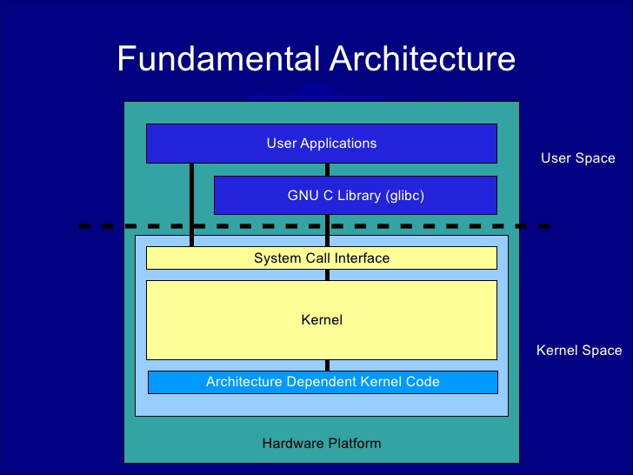
Basic Linux Kernel
Notes:
(C): James F. Kurose and Keith W. Ross

Slide 43

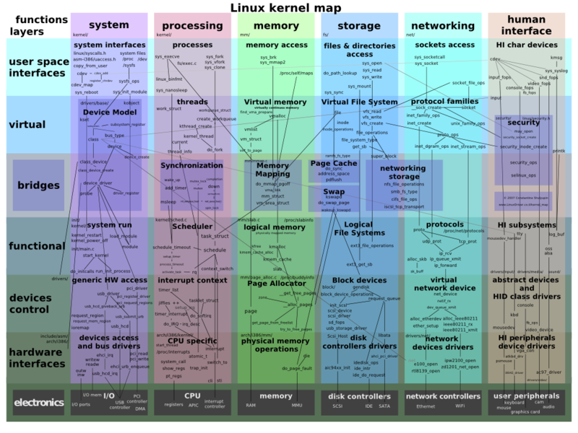
Full Linux Kernel
Notes:
(C): James F. Kurose and Keith W. Ross

Slide 44
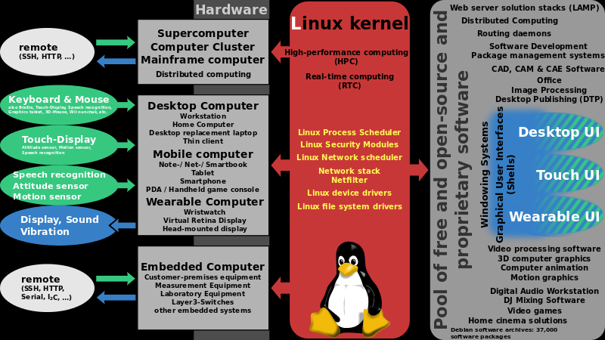
Linux Ubiquity
Notes:
(C): James F. Kurose and Keith W. Ross

Slide 45


Get to Kali already!!!!
Notes:
(C): James F. Kurose and Keith W. Ross

Slide 46
Thank You
Notes:
(C): James F. Kurose and Keith W. Ross
(C): James F. Kurose and Keith W. Ross

Slide 47
Information Security: Level #4
Penetration Testing with Kali Linux
Notes:
(C): James F. Kurose and Keith W. Ross
(C): James F. Kurose and Keith W. Ross

Slide 48
What is Penetration Testing?
“The process of evaluating systems, applications and protocols with the intent of identifying vulnerabilities usually from the perspective of an unprivileged or anonymous user to determine potential real world impacts...”
Or in other words
... we try to break into stuff before the bad guys do...
Notes:
(C): James F. Kurose and Keith W. Ross

Slide 49
What is Kali Linux?
Kali Linux is an advanced Penetration Testing and Security Auditing Linux distribution (distro). Named after a Hindu god.
It was designed to replace the BackTrack Linux distro.
A Linux distro is a operating system based off the Linux kernel.
Think Windows NT and all the Windows distributions (XP, Vista, 7, 8, etc.)
Linux is itself based off the UNIX kernel.
UNIX > Linux > BackTrack > Kali.
Notes:
(C): James F. Kurose and Keith W. Ross

Slide 50
KALI Linux Penetration Testing Programs
KALI Linux is pre-installed with numerous penetration testing programs:
Nmap – A Port scanner
Wireshark – A Packet analyzer
John the Ripper – A Password cracker
Aircrack-ng – For penetration testing of wireless LAN’s
iKat – Hacking tool
Notes:
(C): James F. Kurose and Keith W. Ross

Slide 51
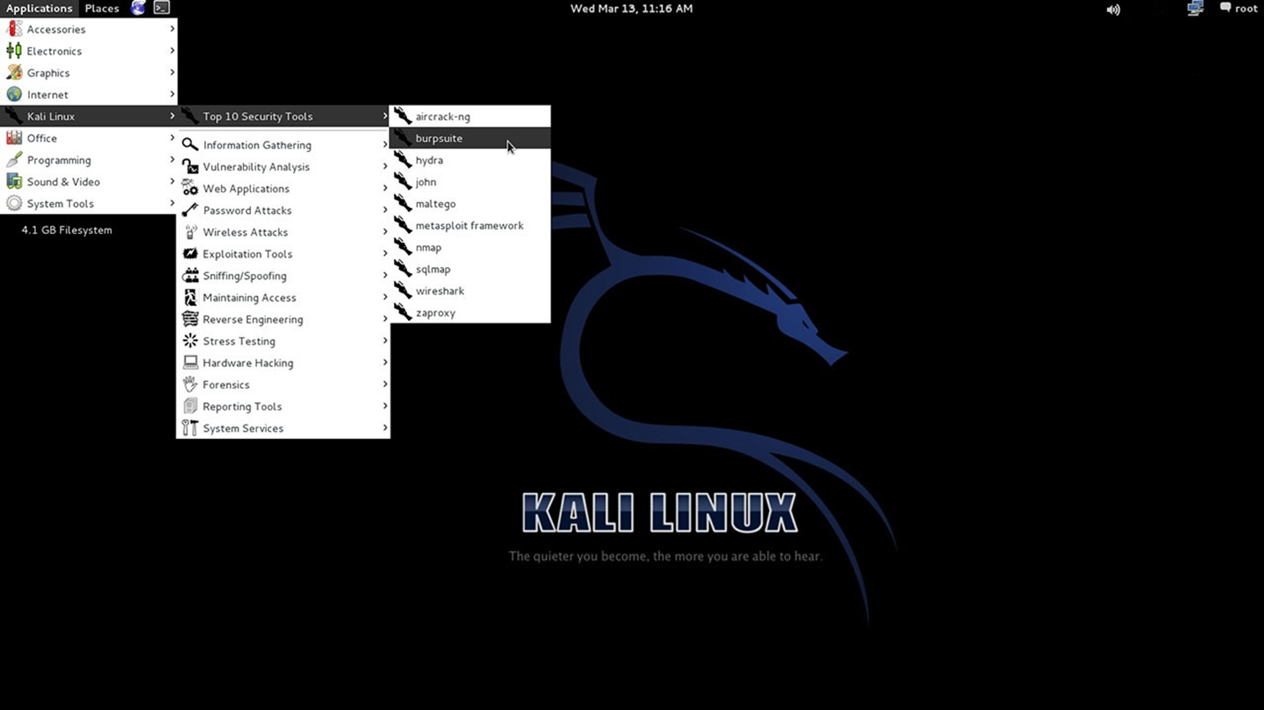
Notes:
(C): James F. Kurose and Keith W. Ross

Slide 52
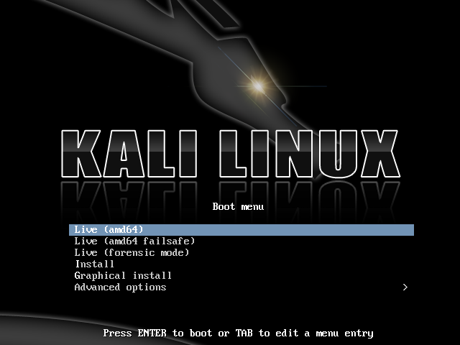
Notes:
(C): James F. Kurose and Keith W. Ross

Slide 53
Why use Kali?
It is FREE!!!!!
300+ applications, from password crackers to digital forensics software.
Vast wireless device support (ARM processors).
Completely Customizable.
Multilingual Support.
Secure Development Environment.
Open source Git tree.
Filesystem Hierarchy Standard (FHS) Compliant.
Gnu Privacy Guard (GPG) secure signed packages and repos.
Notes:
(C): James F. Kurose and Keith W. Ross

Slide 54
Kali’s New Features
Switched from Ubuntu to Debian.
FHS and Debian compliant.
Can now bootstrap and customize Kali ISOs.
Streaming security and package updates from Debian.
Expanded ARM development.
Notes:
(C): James F. Kurose and Keith W. Ross

Slide 55
Kali’s New Features (cont)
Easy upgrade to future versions.
Customizable desktop environment. Automatable Kali Installations.
Streamlined Development Process.
Long Term Tool Packaging and Maintenance.
Notes:
(C): James F. Kurose and Keith W. Ross

Slide 56
Thank You
Notes:
(C): James F. Kurose and Keith W. Ross
(C): James F. Kurose and Keith W. Ross

